Slide 1
Chapter 10
_{Classes and OOP}
10.4 Techniques for Designing Classes
In this PowerPoint presentation, we will discuss the last section of the current chapter, as it’s a theoretical one and is not included in the book for teaching a method. This section is basically belongs into “Coding Techniques and Decorations”

Slide 2
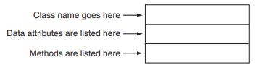
The Unified Modeling Language (UML)
When designing a class, It’s advisable to use UML. It provides a set of diagrams in order to graphically depicting OOP systems.
The UML general layout is divided basically into 3 sections:
The class name
The data attributes (DA) of the class
The methods of the class

Slide 3
Finding the Classes in a Problem (or a Task)
The process of developing an object-oriented program
Identify the classes needed
Identify the different types of the real-world (users) objects
Create the suitable classes for those objects
Remember that your goal is to determine the classes needed in your program

Slide 4
Finding the Classes in a Problem (or a Task)
One simple and popular technique of finding the classes in a problem involves the following steps:
Get a written description of the problem domain
Identify all the nouns (including pronouns and noun phrases) in the description. Each of these is a potential class.
Refine the list to include only the classes that are relevant to the problem.

Slide 5
Writing a Description of the Problem Domain
The Problem Domain is the set of the real-world objects, parties and the major events related to the problem
Understanding the problem (from the person who asked your help) sufficiently is essential for writing the problem domain.
If you can not write the description for the problem domain, you can ask an expert for doing it
The Problem Domain Description is surly must be descriptive in order to ease the process of identifying the names and the purposes of the classes, objects, and the methods

Slide 6
Here is an example of a ready written description for a manager who asked you to write a program that print service quotes for the customers
Joe’s Automotive Shop services foreign cars and specializes in servicing cars made by Mercedes, Porsche, and BMW. When a customer brings a car to the shop, the manager gets the customer’s name, address, and telephone number. The manager then determines the make, model, and year of the car and gives the customer a service quote. The service quote shows the estimated parts charges, estimated labor charges, sales tax, and total estimated charges
Physical objects, like vehicles, cars, products, goods and so on …
The actions (or named the result of business events), like a customer
order, a purchase or so on …
The problem domain description should include any of those
Any role played by a person, like the managers, customers, workers and so on …
Recordkeeping items, like the selling histories, the data of all the users (even the deleted ones) and so on …

Slide 7
_{Identify All of the Nouns}
The next step is to identify all the nouns, noun phrases and even the pronouns(if included) in the description. let’s get back to the previous description and identity them (by underlining them)
Joe’s Automotive Shop services foreign cars and specializes in servicing cars made by Mercedes, Porsche, and BMW. When a customer brings a car to the shop, the manager gets the customer’s name, address, and telephone number. The manager then determines the make, model, and year of the car and gives the customer a service quote. The service quote shows the estimated parts charges, estimated labor charges, sales tax, and total estimated charges
Note that every single noun was underlined, no matter how it can benefits you or even if it was duplicated or not

Slide 8
Here is the list of the nouns after extracting them from the description:
Address
BMW
car
Cars
Customer
estimated labor charges
estimated parts charges
foreign cars
Joe’s Automotive Shop
Make
Manager
Mercedes
Mode
Name
Porsche
sales tax
service quote
Shop
telephone number
total estimated charges
year
This list has many nouns and the vast majority of them are very weak to be considered as a class. Moreover, it includes a too large number of nouns, so the solution is to eliminate those which are not important, and this the next step.

Slide 9
_{Refining the List of Nouns}
As mentioned before, we need to short this list, here are some steps:
Some of the nouns refers to one specific thing: for example, the nouns:
Car & Cars & Foreign Cars (we can depend “Car”)
Shop & Joe’s Automotive Shop (We can depend “Shop”)
So, the new list became:
Address
BMW
car
Cars
Customer
estimated labor charges
estimated parts charges
foreign cars
Joe’s Automotive Shop
Make
Manager
Mercedes
Mode
Name
Porsche
sales tax
service quote
Shop
telephone number
total estimated charges
year

Slide 10
Some of the nouns may refer to refer to items that are not really related to our problem: In our problem, and if you focused well at what you are really asked to do, you will notice that you were asked to print service quotes. Then, nouns like “Shop” is not necessary as the shop is related to selling and offers and so on (it can be classified as a physical object, while the service quote can be classified as an action, Then, we can eliminate the noun “shop”. The same thing for the noun “Manager” refers to a role played by a person that has no relationship with the services quotes.
Note that the noun “Customer” is a role played by a person, but we can’t eliminate it as a service quote refers to him

Slide 11
Some of the nouns refer to objects, not classes: for example, the nouns: “Mercedes ” & “BMW” & “Porsche” can be considered as types of cars (subclasses for the class “car”)
After eliminating those nouns, the list became:
Address
BMW
car
Cars
Customer
estimated labor charges
estimated parts charges
foreign cars
Joe’s Automotive Shop
Make
Manager
Mercedes
Mode
Name
Porsche
sales tax
service quote
Shop
telephone number
total estimated charges
year

Slide 12
Some of the nouns might represent simple values that can be assigned to a variable and do not require a class: while a class consists of DA and methods, some nouns can be considered as attributes for a specific class only. To be more sure, you can ask yourself the following questions:
Would you use a group of related values to represent the item’s state?
Are there any obvious actions to be performed by the item?
If the answer for those two questions were No, then, then the noun probably represents a value that can be stored in a simple variable.
Basing on the mentioned before, we can eliminate the nouns: address, estimated labor charges, estimated parts charges, make, model, name, sales tax, telephone number, total estimated charges, year

Slide 13
After eliminating those nouns, the list became:
Address
BMW
car
Cars
Customer
estimated labor charges
estimated parts charges
foreign cars
Joe’s Automotive Shop
Make
Manager
Mercedes
Mode
Name
Porsche
sales tax
service quote
Shop
telephone number
total estimated charges
year
After all those rounds of elimination, we got 3 nouns (Car & Customer & Service Quote). Then, those will be our classes
class Car
class Customer
class ServiceQuote

Slide 14
Identifying a Class’s Responsibilities
Identifying a class responsibilities is simply to determine the purpose of the class, by identifying 2 things:
What the class is responsible for knowing
What the class is responsible for doing (or operating)
Identifies
What a class need to know
The class DA
identifies
What a class must operate
determining the class methods

Slide 15
Now, we have to answer 2 questions in order to determine the class’s DA and the methods. We can get back to the problem domain description and the nouns list. However, Some of the classes are not literally mentioned in the description.
Referring to the list, we have (till now) 3 classes:
class Car
class Customer
class ServiceQuote
Let’s begin with the class Customer, the description directly mentioned 3 items (all of them are DA, and we concluded that when we eliminate their nouns form the list). The DA are:
The customer’s name
The customer’s address
The customer’s telephone number

Slide 16
WARNING: One of the most common mistakes is to identify too many DA for the class, like the customer’s email address, his wife’s name, his favourite perfume, his weight, and even the size of his underwear! However, If you found that you need to identify more DA, you can easily solve it, so don’t scream. Keep Calm and Programme.
After determining the DA of the class, it’s time to determine the methods of the class (what the class is responsible for doing). Initially, and from the description, the methods available:
1 __init__ method and passing the mentioned DA as parameters
3 setters for the 3 DA
3 getters for the 3 DA

Slide 17
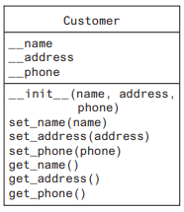
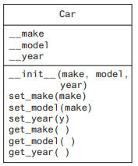
The final UML diagram for the class Customer become:
And by deploying the same steps for the class Car class:

Slide 18
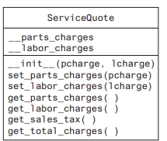
For the class ServiceQuote, the problem domain mentioned the following:
Estimated parts charges (requires setter and getter)
Estimated labor charges (requires setter and getter)
Sales tax (requires methods to calculate and display it)
Total estimated charges (requires methods to calculate and display it)
Then, the final UML diagram for the class ServiceQuote become:

Slide 19
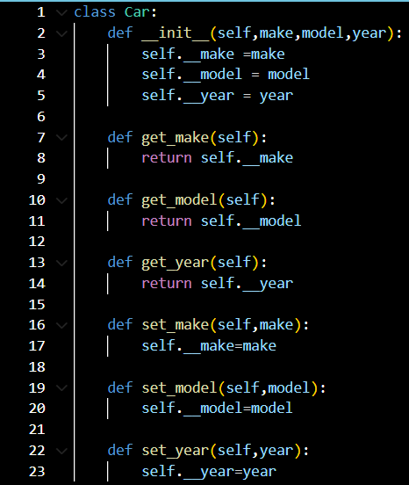
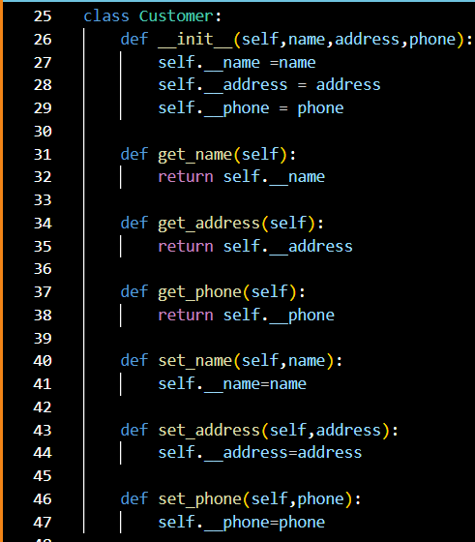
The following two slides illustrate the final results of the code of the three classes:

Slide 20
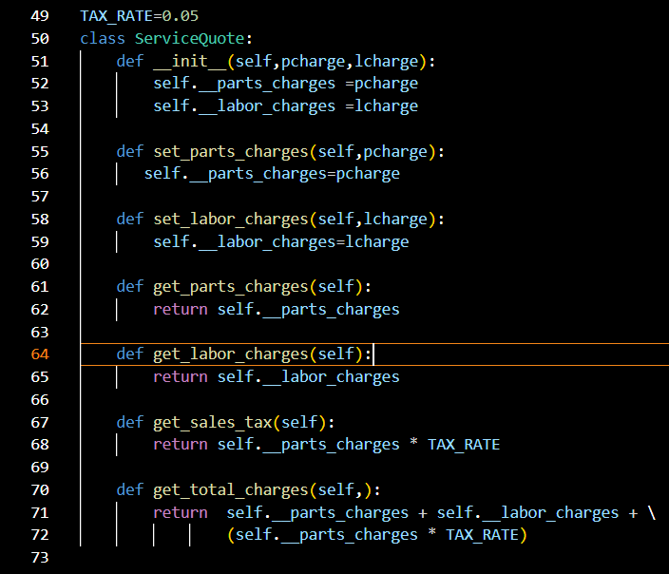
End of Chapter 10

